Slide 1
EXPLORATORY DATA ANALYSIS
US Police Shootings
Dataset :shootings.csv

Slide 2
HYPOTHESIS
The White race records the highest number of shooting each year
Men under the age of 45 are the major victims of police killings.
Los Angeles records the highest number in the killings of blacks
A higher number of police killings happens to the black race
Most black people are unarmed when killed by the police
25% of suspects end up fleeing
Most of the suspect are above 18 years

Slide 3
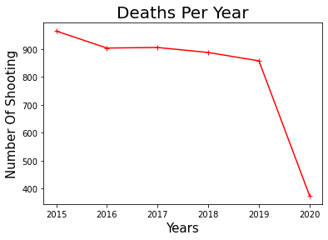
Number of Shootings Per Year
Year | Number of Death
2015 | 965
2016 | 904
2017 | 906
2018 | 888
2019 | 858
2020 | 374

Slide 4
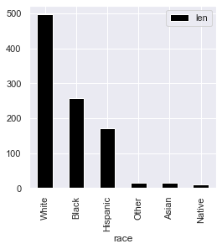
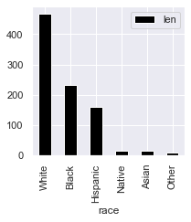
The White race has the highest number of suspects each year
2015
2016

Slide 5
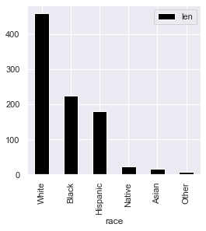

The White race has the highest number of suspects each year
2017
2018

Slide 6
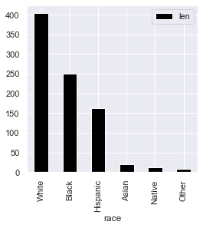
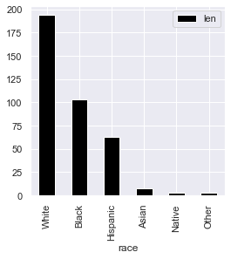
The White race has the highest number of suspects each year TRUE
2019
2020

Slide 7
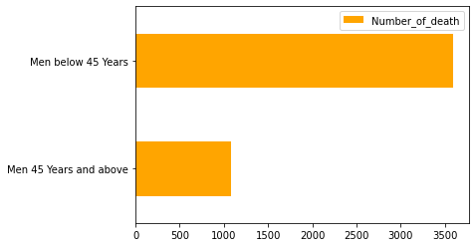
Men under the age of 45 are the major victims of police shootings. TRUE
Visualizing
Actual Figure
Men Deaths under and over 45years
Age | Number of Men
Over 45 year | 1,082
Under 45 | 3,591

Slide 8
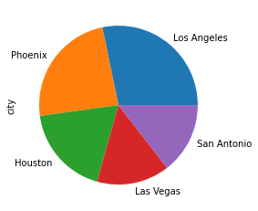
Los Angeles City records the highest number in the Shooting. TRUE
Cities | Deaths
Los Angeles | 78
Phoenix | 66
Houston | 51
Las Vegas | 41
San Antonio | 40

Slide 9
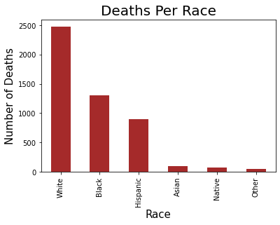
A higher number of police shooting happens to the black Race. FALSE
Race | Number
White | 2476
Black | 1298
Hispanic | 902
Asian | 93
Native | 78
Other | 48

Slide 10
Most black people are unarmed when killed by the police . FALSE
Blacks Unarmed | Blacks armed
123 | 1,175

Slide 11
Most black people are unarmed when killed by the police
Case Of Armed Blacks without Video Cameras
Blacks Unarmed | Blacks armed
123 | 1,175
Blacks armed | Without Video Cameras
1,175 | 994
Deduction (proof) | Percentage (no proof)
181 | 85%

Slide 12
25% of suspects end up fleeing the police. False
Number of suspects
Percentage
Fled Cases | No Fled Case
1,822 | 3,073
Fled Cases | No Fled Case
37% | 63%

Slide 13
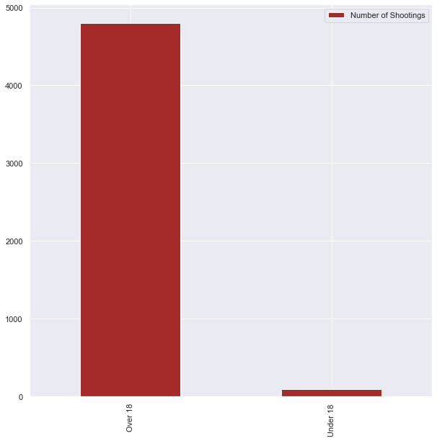
Most of the suspect are above 18 years
Visualization
Actual Number
Ages | Number of Shootings
Over 18 | 4,798
Under 18 | 97

Slide 14
Most black people are unarmed when killed by the police

